Slide 1
ChangeMakers
PITCH TEMPLATE

Slide 2
Company logo
Slogan/tagline

Slide 3
Slide 1 - Introduction
The first slide presents the company name, the team and contact information.
It pays to also have a short slogan/tag line, which presents what the company does and what it wants to influence.
Keep it short and memorable!

Slide 4
Slide 2 - The problem and current solutions
What problem have you identified?
How do you know it is a problem?
How is the problem currently being solved?
What are the companies doing right or wrong?

Slide 5
Slide 3 - Solution and value promise
Present your customers and how they use your product
Images and videos are more effective than a lot of text
Why is your product the best way to solve the problem?
What is your value promise?
If you have the opportunity to show a prototype, do it!

Slide 6
Slide 4 - Validation
How have you investigated that the problem exists?
How do you know that your company's solution is the best on the market?
How have you investigated the market's size and its interest in your product?
Present concrete things and actions.

Slide 7
Slide 5 - The market
Define the market.
What industry do you belong to?
Market size in money?
What is the company's market position?
Customers. Clearly state who the company's customers are.
Are there micro / macro trends in the background? For example, insect food, which may be a food trend in the future.
Are there enough people who are ready to pay for your product? How did you find it out?

Slide 8
Slide 6 - The business model
Who are your customers?
Describe the ideal customer as accurately as possible.
What is your pricing model like?
What are the company's revenue streams?
What are your main sales and marketing channels through which you reach your customers?

Slide 9
Slide 7 - The team
What is the competence of the team?
Where does the competence come from, use concrete examples.
How much further competence does the team need to develop?

Slide 10
Slide 8 - Financial figures
What are the company's key financial figures
How large is the product's gross margin?
How much sales are needed?
How large start-up investments are needed. Make an estimate of the future economy (eg 1-3 year plan):
Number of customers
Sales
Costs
Profit

Slide 11
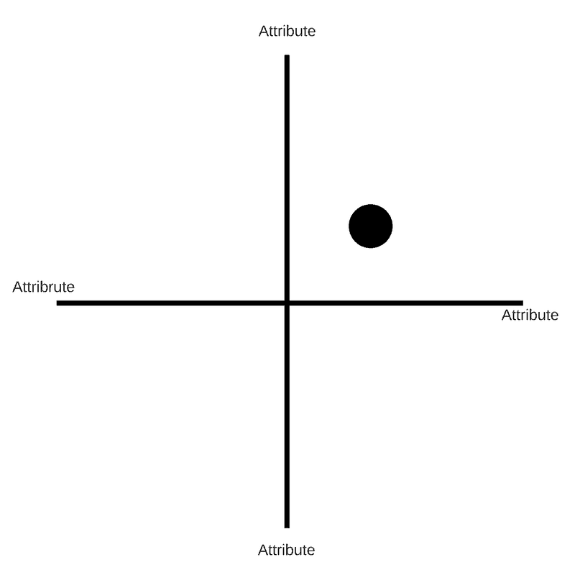
Slide 9 - Competitor analysis
What is your position in the market?
What are your company's strengths & weaknesses compared to competitors?
How do you differentiate yourself from the others?
Who are your most important direct competitors?
How do you really differ from them and in what way are you better?

Slide 12
Slide 10 - The future
What are the company's opportunities in the long term?
What is the company's market position in the future, for example in 5 years?
How do you intend to achieve this?

Slide 13
Slide 11 - The request
What kind of investment are you looking for?
What kind of help do you need? (Help with entering the market, collaboration, etc.)
Who are your most important current partners?
If you get an investment, what will you use it for:
Salaries, permits, entering the market, sales and marketing, developing the product/service, tools, machines?

Slide 14
Thank you!

